Slide 1

Design Jam
YOUR BRIEF

Slide 2
The Big Picture
We want every child and young person to experience the enjoyment and benefits that being active can bring. Their needs, expectations and safety should come first in the design and delivery of activity.
​The Big Question
How might we put young people’s voice (their ideas and opinions) at the heart of Sport England’s work, and support other organisations ​to do the same?
This is about giving more young people access to physical activity that is inclusive, enjoyable and rewarding for them by listening to the voices that are often left out.
Over to you...

Slide 3
Youth voice is the right of young people to be heard.
It’s your ideas and opinions being listened to and acted upon.

Slide 4
What have other organisations been doing to embed youth voice?​
Redbull
Young athletes take over Red Bull's social networks during extreme sports events
Netflix
Any viewer can influence the shows on Netflix by rating them or suggesting new series
Nike
Young people can share their virtual medals from Nike on social media to inspire others
Snapchat
Snapchat conducts interactive polls where users can vote on features or content directly in the app
YouTube
Creators and viewers can voice their opinions on platform policies and updates at YouTube's online forums
Under Armour
Under Armour's Youth Advisory Board advises on new sportswear designs and marketing strategies
UNICEF
UNICEF's Youth Ambassadors advocate for children's rights and campaign to promote education and health initiatives
Microsoft
Microsoft partners with young researchers to study digital inclusion and develop educational tools
Reebok
Reebok hosts innovation labs where young engineers collaborate to create sustainable sportswear materials
Airbnb
Airbnb develops a platform where young travelers collaborate on travel itineraries and cultural experiences, influencing travel trends
Disney
Disney has a platform for young fans to submit fan fiction and artwork, building community between fans
LEGO
LEGO Ideas allows young fans to submit and vote on new set designs
Youth Justice Advisors
A team of Young Adults aged 18-30 with lived experiences of the Care and Justice System focus on highlighting the voices of those in the systems and are all passionate about seeing informed reform
St John's Ambulance
'Young Responders' build confidence in first aid skills and mental health resilience, reflect young people’s experiences in the training content and learn flexibly around their other commitments
Hope Hack
Enables vulnerable communities to be free from violence, poverty and discrimination. This is done by dco-designing solutions for young people, amplifying their voices and focusing on their future hopes

Slide 5
What stops young people from being active?
There are not the right type of activities available to them
Opportunities are too far away, and they can't afford to travel there
It's too expensive
They don't find taking part fun
The other young people in the club or activity don't look like them, so they get put off
Their parents or guardians don't have time to take them to sports activities
They don't have the confidence to take part
Some people have had bad experiences such as racism so they don't want to go back
Many are self-conscious about how they look, the shape of their body
The sports they like are just too competitive
We need to understand which barriers are most important to address first.
This is why it's so important that we give young people a voice, and co-design solutions that will help them get active.
Taken from statistics about people aged 5 to 16

Slide 6
Who is less likely to be active?
Everyone has a set of characteristics that affect how active they are. ​
According to statistics, the following characteristics can mean certain children and young people are less active:​
Gender identity: young people who identify as having a gender identity that is not exclusively male or female (at secondary age)
Girls
Low affluence
Disabled people and those with a long-term health condition
Asian background
Black background
If a young person has 2 or more of these characteristics, such as they are Asian and live in a less affluent community, then are much more likely to be inactive.

Slide 7
We spoke to 15 organisations that work with young people and heard that:
1. There are different opinions around the definition, terminology and scope of ‘youth voice’
2. For some it is hard to find relevant examples to learn from when it comes to successfully embedding youth voice – particularly how to begin
3. Getting youth voice to be meaningful and regular requires resource (e.g. money and time) and capacity which are often scarce
4. Many don't feel confident about bringing young people into decision making and worry about safeguarding
5. The culture might get in the way of embedding youth voice. Not everyone can see its value – some people think professionals should make all decisions
6. It can be difficult to engage with ‘all’ young people, often leaving certain voices unheard, which leads to things being designed with only some people in mind

Slide 8

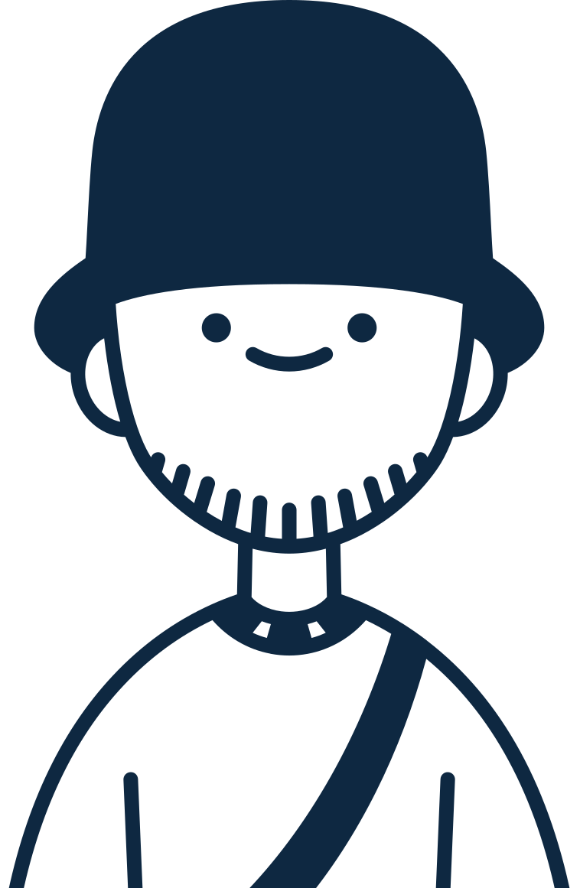
Young people have told us to prioritise these
5 design principles:
Connection and trusted relationships are important to young people - with each other and with adults working with them.
The purpose and role of the young people's involvement should be clear and time bound.
The format should allow young people to participate on their own terms and must be accessible.
Young people want to be rewarded,
receive feedback on and be credited for their contributions e.g. qualifications or vouchers.
Young people want to be part of a process from start to finish and make a meaningful contribution, not brought-in a tokenistic way.

Slide 9
Over the following pages are examples of some young people we want to hear more from.
Notice that different young people have very different experiences of physical activity.

Slide 10





Zaynab: 17, Kent
Zaynab is passionate about healthy living and shares nutritious halal recipes on her Instagram account.
She loves exercising outside in summer, but come winter, she doesn't feel comfortable being the only person wearing a hijab at her gym.
Strengths
Motivators
Social media and content creation
Hugely motivated
Funny and friendly
Stop feeling so sluggish and depressed during the winter
Passion for equality!
Struggles
What could help Zaynab?
Raise awareness of issues young people face in being active, such as tackling discrimination and normalising wearing hijabs in sport.
Listen to what Zaynab needs and co-create solutions
Feeling isolated in a very white area

Slide 11





Bibi: 21, South London
Bibi hated PE in school – having to wear shorts, a highly competitive culture and running around a muddy field.
Bibi started doing online Yoga in the pandemic and now she's mad that she wasted so many years thinking she "wasn't sporty".
Strengths
Motivators
Graphic Design
Singing in a band
3-minute headstand
Determination
Wants to see more 'not sporty' girls like her enjoying moving and having strong bodies
Struggles
What could help Bibi?
Share Bibi's story to inspire others
Engage Bibi and others in creating guidance for PE teachers
Still hates people seeing her in shorts

Slide 12





Ray: 15, Devon
Ray started using they/them pronouns two years ago. They had a tough time explaining their transition to the running club and experienced bullying. Ray is passionate about ensuring others don't experience the same struggle.
Strengths
Motivators
Self-knowledge
Understanding regional bylaws
Long distance running
Saving other non-binary and Trans people from the pain and stress they went through
Struggles
What could help Ray?
Give Ray a platform to share their story and support other sports clubs to be inclusive
Create or circulate Trans and non-binary specific guidance and training for the physical activity sector – co-created with young people like Ray
Being able to choose the activity they want to take part in and how
Ray feels adults don't listen or take them seriously
Feeling discouraged

Slide 13
Your question...
How might Sport England involve more young people in the decisions they make?
Sport England don’t currently have a way to speak directly to young people. We would like to involve young people in processes and decisions that could impact them.
What should Sport England do to create opportunities for young people to have a voice in a way that is inclusive, meaningful, and rewarding for young people? How do we make this accessible to any young person who wants to be involved?

Slide 14

Some ideas
Senior Sport England staff are buddied up with a young person who supports them in making big decisions.
Local assemblies: partner with schools and community centres to conduct workshops and assemblies where young people can voice their opinions on key Sport England decisions and build this into the regular organisational process.
Young people attend different events where personal stories can be shared and amplified. Young people have an alumni mentor someone who has knowledge and understands how to ensure voices are heard.
An interactive platform where young people can share ideas, vote on proposals and share their experiences.
A paid Sport England youth panel that advise on decisions that will impact young people nationally. Young people could be nominated yearly by their local schools, clubs or groups.
Recruit young ambassadors who are passionate about sports and physical activity to represent their peers and relay feedback to Sport England.

Slide 15
Your idea
Must
Prioritise the 5 design principles and:
Consider how young people's ideas can be acted on, not just heard
Make space for young people whose voices may be heard less
Consider the needs of Sport England staff – what do they need to be able to do this effectively?
Should
Promote peer to peer support and connection amongst young people.
Have confident and competent adults on hand to facilitate, support and encourage young people
Include a personalised mechanism for thanking young people
Could
Provide young people with development opportunities e.g. training
Provide training for Sport England staff so that they can listen and act on young people's views.
Won't
Have unlimited funds to do this.
Make decisions without any input from Sport England staff and decision makers.

Slide 16
5 Questions we'd love you to consider...
What type of decisions should young people be involved in? E.g. developing new ideas, creating policies, funding programmes
What reward and/or recognition should young people get for being part of this? E.g. qualifications, vouchers, featured social media
How might we find the balance between young people's views and Sport England's needs and priorities? How can we support young people to work productively with staff?
How might we balance differing preferences, and engage with a range of young people, especially those whose voices are less often heard?
How do we make sure young people's views are acted upon? Note that many partners have reported that boards can become 'talking shops'.

Slide 17





Think about people like:
Hannah: 47, Loughborough
Hannah has worked at Sport England for 10 years. Her role involves advocating for disabled young people to be able to access sport and physical activity. Hannah needs to identify partners to invest money into and wants to engage young people in this decision.
Strengths
Motivators
Listening to young people
Desire to try out new things
Knowledge of Sport England
Wants to collaborate with different teams at Sport England to ensure the best outcomes for young people
Doesn't want to be making decisions that impact young people without them
Struggles
What could help Hannah?
Understanding how young people could support the decision-making process – what would young people like to be involved in and how?
Processes built with young people's views and inputs embedded – like funding
Nervousness within Sport England about trying something new
Currently no funding behind this work, so Hannah needs to show the impact of embedding youth voice

Slide 18
Your question...
How might organisations hear from the young people in local places who face the greatest inequality?
We heard that organisations delivering sport and physical activity struggle to hear from young people in local places who face the greatest inequalities, so their solutions don’t always meet local need.
How can organisations be supported to create opportunities for young people to express their ideas, opinions, and needs in their community? How can young people be engaged in a way that is purposeful, meaningful and rewarding? How can we share this learning with other organisations?

Slide 19
Some ideas
Network of local youth ambassadors that conduct peer research in their area and feed into a national network of youth ambassadors.
Local problems are taken to a diverse group of local young people to work through, with outputs shared across partners.
Young people that represent different organisations come together locally to identify and solve problems. Act as young researchers to hear from different young people.
Young people are supported to sit on local boards/ groups that oversee the decision making in local areas.
Young people currently volunteering in national organisations are buddied up to local young people to co-design solutions to problems and better connect national and local groups.

Slide 20
Your idea
Must
Prioritise the 5 design principles and:
Make space for young people whose voices may be heard less
Have the flexibility to work for a range of different local areas (city, town, rural, rich, poor) allowing places to shape this in a way that works for them.
Provide a mechanism to feed local learning into national agendas.
Should
Promote relationships amongst young people and between organisations
Have confident and competent adults on hand to facilitate, support and encourage young people.
Keep it simple to encourage participation
Increase the capacity of local and national organisations to be able to hear from young people.
Could
Provide training for young people in how to conduct peer research and give them development opportunities.
Provide a framework for how young people should be considered in local decision making.
Be organised based on an area or theme.
Connect with existing campaigns or advocacy networks locally
Won't
Be an isolated project or programme.
Be able to cover the entire nation – it will need to prioritise specific places to start.
Be complex and bureaucratic.
Be too time consuming or costly for local organisations to implement.

Slide 21
5 Questions we'd love you to consider...
How do we get the right partners and Young People together? Who is the convener?
How do we amplify the voices of least heard young people? How do we ensure their needs are considered?
How can we incentivise participation and successful project outcomes?
How do we share learning and good practice with Sport England, partners and young people, to spread good work?
As a national organisation, what role should Sport England & others play? E.g. to collaborate with local stakeholders. And help them forge important connections in their area?

Slide 22

Think about people like:
Shivani: 47, Loughborough
Shivani is the Children and Young People's Lead at a National Governing Body of Sport (NGB). Shivani coordinates the NGB's Youth Advisory group which was established 3 years ago. Shivani manages lots of workstreams and wishes she had more time to spend with the Youth Advisory group and could hear from a broader range of young people.
Strengths
Motivators
Passionate about creating great physical activity experiences for young people
Expert relationship builder
Wants to involve young people more in the work of the organisation, as she has seen positive impact of this
Young people in the group are keen to do some research with their peers in the sport to find out a wider range of views
Wants to learn how to engage different young people and diversify who is playing their sport
Struggles
Working nationally means Shivani struggles to connect with young people in their communities – she relies on young people putting themselves forward for the youth advisory board
Challenge to convince NGB senior leaders to take youth voice seriously
Stretched resources
What could help Shivani?
Help Shivani to hear the views of young people in different local areas
Connect Shivani to other organisations doing good work in youth voice

Slide 23

Think about people like:
Ali: 34, Bristol
Ali is the national lead for a charity focussed on getting more people active in his town. He is passionate about supporting young people.
His local leads tell him there's no point running youth sessions – young people never show up.
Strengths
Motivators
Seeing the big picture
Leading by doing
Grow the charity and see more young people being active in his town
Secure next year's grant funding
Struggles
What could help Ali?
Getting used to leading from behind a desk
Dyslexia
Support to understand why young people aren't showing up and recruit in new ways
Connections to local young people or partner organisations to share learning and insight about what young people want.

Slide 24
Your question...
How might Sport England amplify the voices of young people so that they are heard and acted on by organisations who are delivering sport and physical activity?
Young people are best placed to identify and explain what needs to change to help them get active. Sport England can also influence others and how they work.
How can we highlight young people's priorities and share them in a way that is meaningful? How can we amplify the barriers of young people facing the greatest inequalities? How can we demonstrate the value of acting on youth voice for organisations?

Slide 25
Some ideas
Create a collective of individuals who are committed to embedding youth voice, which could be a combination of young people and people from organisations.
Young spokespeople – young people who speak alongside the CEO, on behalf of Sport England and represent the views of young people.
Create personas for young people by young people that can be used to design sport and physical experiences.
Social media takeovers – either locally or nationally.
Campaigns - Embed youth voice in campaigns where young people choose what is spoken about and how
Website pages authored by and dedicated to youth voice
Roundtables hosted by young people for the politicians in their local area.

Slide 26
Your idea
Must
Prioritise the 5 design principles and:
Consider how young people's ideas can be acted on, not just heard
Make space for young people whose voices may be heard less
Should
Promote peer to peer support and connection amongst young people.
Have confident and competent adults on hand to facilitate, support and encourage young people
Include a personalised mechanism for thanking young people
Could
Provide young people with communication, public speaking and social media skills and training
Provide training for organisations so that they can listen and act on young people's views.
Won't
Be a completely new platform or website – it needs to be built into existing.
Contradict or conflict Sport England's purpose and partner guidance.

Slide 27
5 Questions we'd love you to consider...
How do we identify the right organisations to connect with? Which organisations are best to help amplify young people's voices?
How might we balance differing preferences, and engage with a range of young people, especially those whose voices are less often heard?
How do we share learning and good practice with Sport England, partners and young people, to spread good work?
What reward and/or recognition should young people get for being part of this? E.g. qualifications, vouchers, featured social media
Who are the people we want to influence? Who’s perception do we want to change?

Slide 28

Think about people like:
Lucy: 35, Stockport
Lucy has worked at Sport England for 7 years.
Her role involves advocating for young people to access physical activity in a way that is meaningful for them. Lucy needs to influence colleagues at Sport England to want to put youth voice at the heart of their work.
Strengths
Motivators
Listening to young people.
Desire to try out new things.
Knowledge of Sport England.
Wants to influence colleagues to embed youth voice in their work
Enjoys working with young people, they have amazing new ideas!
Struggles
What could help Lucy?
Nervousness within Sport England about trying something new.
Some colleagues don’t understand the value of listening to young people – don’t we already know what they want?
Understanding how she can amplify the voices of young people to positively influence her colleagues?
Ideas that are easy for her to try to show the value to her colleagues

Slide 29
Your question...
How might we support organisations to learn and test new ideas to embed youth voice?
Organisations can have low confidence and limited capacity to try new things. We know they want to learn the skills to do this, particularly to come up with ideas that help young people who are most impacted by inequalities.
What support and guidance would organisations need to be confident doing this? How could young people be involved in a purposeful, meaningful, and rewarding way? How can we create a supportive environment where young people and organisations can co-design solutions? And learn together?

Slide 30
Some ideas
Sport England brings in experts to help organisations to learn about youth voice – why, how and what.
Organisations are put into learning groups with shared problems to solve together.
Young people co-design and deliver support to partners on how to engage young people, supported by expert partners.
Partners are embedded in existing Youth networks locally and mentored by trusted local leaders and young people
Hackathons / Jams (like this one!) where young people help organisations to come up with new ideas and solutions
Creating a way for organisations to consult with young people at different stages of a project e.g. young people give feedback on the ideas.
Young people review the organisations who apply to be part of the programme – decide who is involved.

Slide 31
Your idea
Must
Prioritise the 5 design principles and:
Consider the role young people can play that is of most value to them
help organisations to build their confidence and skills to apply youth voice
Prioritise the views of young people that are most impacted by inequalities
Should
Share learning and feedback with Sport England
Support organisations to take more risk
Support organisations to reach young people in new ways
Let partners test ideas, receive feedback and make changes
Could
Not be limited to organisations working in the sport and physical activity sector
Provide training and coaching
Provide resources
Involve groups of organisations and young people working together
Offer participation incentives.
Won't
Have the capacity to include all organisations – we will have to select who can be involved.
Offer ongoing funding – sustainability is key

Slide 32
5 Questions we'd love you to consider...
Who would be involved? What organisations receive support? Who are the young people?
What type of support would this include? How do we help organisations to build their confidence with youth voice?
How can we create a supportive environment for organisations to try new things quickly and to learn quickly?
What reward and/or recognition should young people get for being part of this? E.g. qualifications, vouchers, featured social media
How can young people help share the impact to get more organisations to embed youth voice?

Slide 33


Think about people like:
El: 34, Nottingham
El works for a local community sport organisation.
For this organisation they work with young people regularly. She's looking to engage more young people in the area, from a range of backgrounds. El's local area has high crime rates, but she has seen that getting involved in sport can give young people a positive purpose.
Strengths
Motivators
Local area knowledge
Listening to young people
Concerned about growing inactivity in the area.
Ensuring activities reflect what the young people want to do and enjoy.
Seeing young people grow and develop.
Struggles
What could help El?
Limited connections with organisations out of the area.
Lack of funding to try new things – wants to test how to reach young people impacted by crime and hear their voice.
Provide training, support and a safe space to test new ways to engage young people – specifically those from a diverse range of backgrounds.

